Slide 1



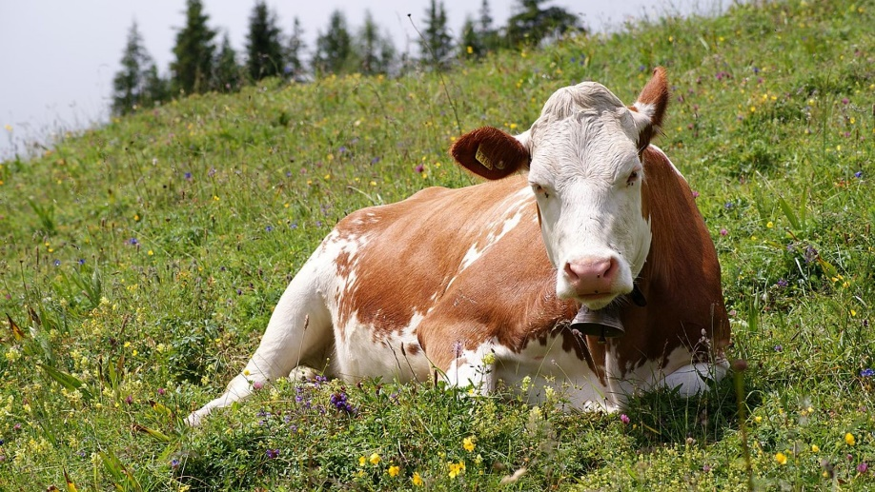
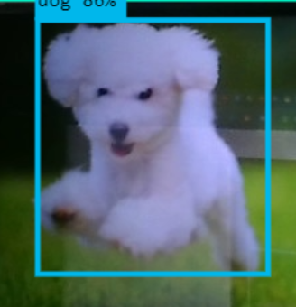
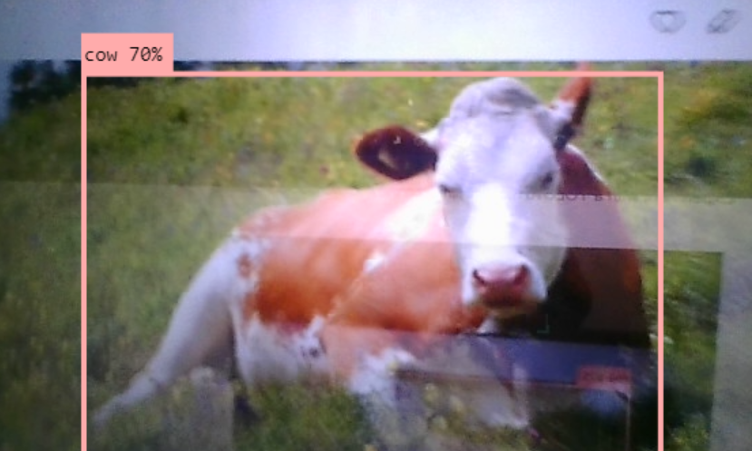
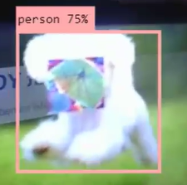
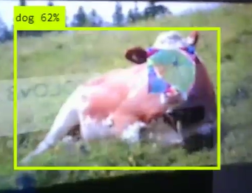
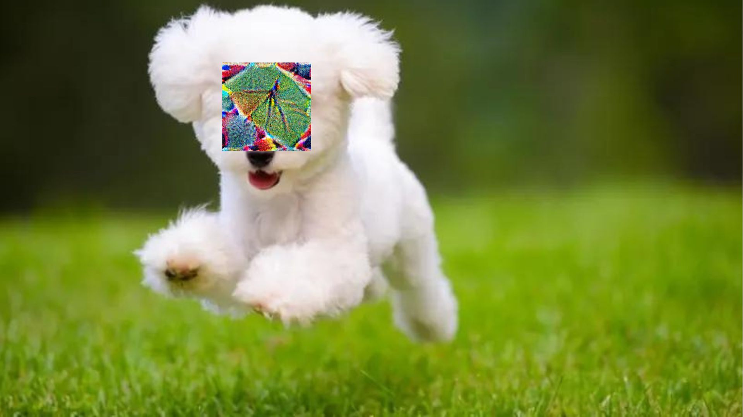
Adversarial Patches Terrelle Thomas*, Idongesit Mkpong-Ruffin*, Chutima Boonthum-Denecke** FAMU Dept of Computer & Information of Sciences*, Hampton University, Dept of Computer Science**
Purpose
Materials
Results
Discussion
The aim is to understand better the process involved in adversarial patches overlaid on an original picture, causing the model to give inaccurate predictions. Subsequently, the intention is to develop a defense strategy utilizing a Generative Neural Architecture (GNA) equipped with a three-pipeline anomaly detection system. This strategy aims to mitigate the effectiveness of adversarial patches by comprehensively understanding how overlaid patches function as additional perturbations, obscuring specific portions of the original image. It is recognized that these inherent and overlaid perturbations contribute to inaccuracies in the model’s predictions, underscoring the necessity for a robust defense mechanism.
Detection Model: Yolov8- https://github.com/ultralytics/ultralytics
Electronic: Laptop, Phone
Adversarial Patches
The findings of this study align with previous research, such as "X-Detect: Explainable Adversarial Patch Detection for Object Detectors in Retail" by Omar Hofman et al., which illustrates the deliberate selection of computerized, human-edited inputs by attackers to deceive AI models. Adversarial patch attacks, exemplified by 3D image-like patches strategically placed within scenes, aim to manipulate object detection systems. Our experimentation further validates the hypothesis that when such patches overlap the original image, they introduce perturbations, obscuring specific areas. The significance of this study lies in highlighting the detrimental impact of overlaid patches on model predictions. By demonstrating how inherent and overlaid perturbations contribute to inaccuracies in detection systems, our findings underscore the critical importance of robust defense mechanisms against adversarial attacks. Additionally, we recognize that the size and position of the overlaid patch on the original image are key factors contributing to the perturbations that manipulate object detection systems.
Hypothesis
Methods
It is hypothesized that when a patch overlaps the original image, it causes perturbation in the original image, obscuring specific portions of it. Consequently, overlaid perturbations contribute to inaccuracies in model predictions.
The original picture is positioned before the detection system to facilitate identification and classification of its content.
Results obtained from the detection system are recorded.
When the patch was overlaid onto the original picture, analyzation and results obtained from the detection system are recorded.
The detection results obtained before and after overlaying the patch on the original picture are analyzed. The impact of the original image and overlaid patch on the image was recorded and analyzed
Background
Artificial intelligence involves developing computer systems that perform tasks typically requiring human intelligence, such as visual perception and speech recognition. The paper "Adversarial Patch" by Tom B. Brown et al. examines how specifically crafted computerized inputs, like 3D image-like patches of a toaster, can be inserted into a scene (e.g., a tabletop with a banana and notebook) to deceive or manipulate machine learning models. This is known as an adversarial patch attack.
Previous research, such as “X-Detect: Explainable Adversarial Patch Detection for Object Detectors in Retail” by Omar Hofman et al. and others, has shown that attackers meticulously select computerized, human-edited inputs—such as 3D image-like patches, for example, toaster-placed in a tabletop scene alongside a banana and notebook—to deceive or manipulate AI models. This type of attack is known as an adversarial patch attack. Attackers deploy adversarial patches with varying characteristics across different scene sections where object detection occurs.
We aim to emulate their methodology to understand better how adversarial patches are created and then plan to implement a defense strategy using a Generative Neural Architecture (GNA) with a three-pipeline anomaly detection system to mitigate the use of adversarial patches. This strategy is based on the research “Anomaly Unveiled: Securing Image Classification against Adversarial Patch Attacks” by Nandish Chattopadhyay et al. As the three-step pipeline progresses through the network, the data undergoes a comprehensive process of comparison, analysis, and refinement, all centered around anomaly detection. This process continues until the data is returned in a refined state, effectively neutralizing its potential to function as an adversarial patch.
Image | Dimensions | Object Detected | Percent | Preprocess Speed (ms) | Inference Speed (ms) | Postprocess Speed (ms)
O-Cow.jpg | 384x640 | Cow | >70% | 4.1 | 895.3 | 8.0
O-Puppy.jpg | 384x640 | Dog | >70% | 4.4 | 944.2 | 7.0
Conclusion
In conclusion, our experimentation has confirmed the hypothesis regarding the impact of overlaid patches on the original image. We have demonstrated that when a patch overlaps the original image, it acts as a perturbation, obscuring specific areas. Consequently, the presence of both inherent and overlaid perturbations significantly contributes to inaccuracies in model predictions, highlighting the importance of considering such perturbations in model development and assessment. Moving forward, we aim to establish a methodology to understand better the process involved in creating adversarial patches. Subsequently, we plan to develop a defense strategy utilizing a Generative Neural Architecture (GNA) equipped with a three-pipeline anomaly detection system to mitigate the effectiveness of adversarial patches by comprehensively understanding how overlaid patches function as additional perturbations, thus underscoring the necessity for a robust defense mechanism.
(a)
(b)
Image File | Resolution | Objects Detected | Percentage | Preprocess Speed | Inference Speed | Postprocess Speed
E-Cows.jpg | 384x640 | dog | 62% | 7.6ms | 1329.7ms | 18.8ms
E-Dog.jpg | 384x640 | person | 75% | 56.8ms | 1575.0ms | 39.7ms
Acknowledgements
This material is based upon work supported by the National Science Foundation under Grant No. (2131256 ) and the FAMU Title III Undergraduate Research Program Project 40023 and the FAMU Office of Undergraduate Research.

